Slide 1
EE and DR Inputs into RPM
4/23/2020
RAAC/SAAC Webinar
John Ollis

Slide 2
Summary
EE curves (sample data)
EE price vs aMW (by bin)
EE peak MW contribution (by bin)
EE on vs off peak (by quarter)
EE ramp multipliers and max contribution (by bin, period)
DR curves (sample data)
DR costs (by bin)
DR peak and aMW contribution (by bin)
DR maximum ramp per year and for the study (by bin)
EE/DR Elasticity Array
Modifies DR availability by uptake of EE (can increase or decrease DR)
Indexed by EE bin and DR bin

Slide 3
Quick Summary of EE and DR Supply Curves

Slide 4
Conservation By Bin Price and Total aMW
Conservation Bucket | Price ($/MWh) | Energy (MWa)
1 | -46 | 1092
2 | 5 | 1548
3 | 15 | 1917
4 | 24 | 2188
5 | 33 | 2826
6 | 44 | 3331
7 | 56 | 4332
8 | 64 | 4839
9 | 75 | 5081
10 | 84 | 5295
11 | 94 | 5356
12 | 115 | 5542
13 | 146 | 5820
14 | 562 | 6586

Slide 5
Peak MW Contribution By Bucket
Conservation Bucket | 1 | 2 | 3 | 4
1 | 1343 | 3430 | 3430 | 1343
2 | 1866 | 4302 | 4302 | 1866
3 | 2301 | 5047 | 5047 | 2301
4 | 2609 | 5465 | 5465 | 2609
5 | 3432 | 6416 | 6416 | 3432
6 | 4084 | 7452 | 7452 | 4084
7 | 5411 | 9859 | 9859 | 5411
8 | 6411 | 10899 | 10899 | 6411
9 | 6787 | 11251 | 11251 | 6787
10 | 7182 | 11601 | 11601 | 7182
11 | 7313 | 11676 | 11676 | 7313
12 | 7767 | 11906 | 11906 | 7767
13 | 8476 | 12505 | 12505 | 8476
14 | 10365 | 14718 | 14718 | 10365

Slide 6
On and Off Peak Percentages Recall: Definitions have changed
SubAnnual Block | OffPeak | OnPeak
1 | 1.732421 | 0.315094
2 | 1.555689 | 0.267219
3 | 1.768202 | 0.312071
4 | 1.733066 | 0.309774

Slide 7
Further details on EE online
https://www.nwcouncil.org/2021-power-plan-technical-information-and-data

Slide 8
Quick DR Summary

Slide 9
Some Prices and Magnitudes…
 | Price ($/kW-yr) | 2026 Winter | 2031 Winter | 2041 Winter | 2025 Summer | 2030 Summer | 2040 Summer
Demand Response Price Bin 1 | 2 | 452 | 708 | 741 | 1146 | 1677 | 1916
Demand Response Price Bin 2 | 11 | 205 | 210 | 221 | 337 | 419 | 442
Demand Response Price Bin 3 | 37 | 586 | 662 | 790 | 36 | 85 | 165
Demand Response Price Bin 4 | 79 | 637 | 674 | 758 | 501 | 666 | 763

Slide 10
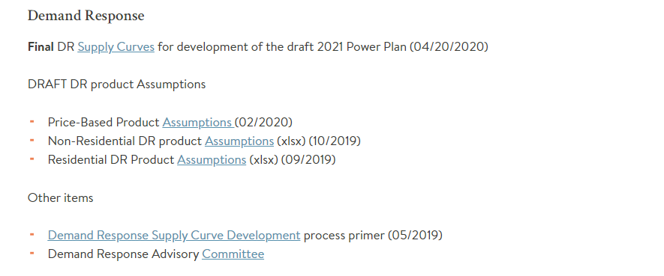
Further details on DR online
https://www.nwcouncil.org/2021-power-plan-technical-information-and-data

Slide 11
DR/EE Interaction

Slide 12
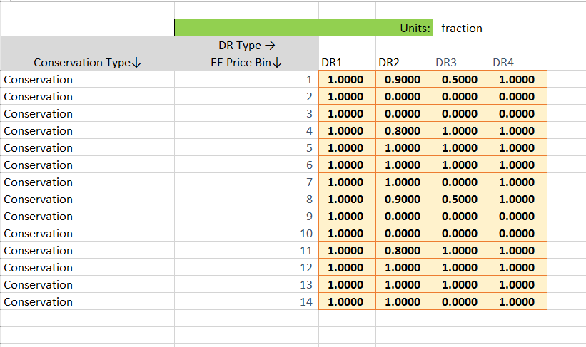
EE/DR Interaction
Talked about this previously in multiple SAAC meetings and System Integration Forum.
Initially, it appeared we would not be able to model EE and DR interaction dynamically, but it appears to some extent we may.
A multiplier is applied to derate/increase the amount of available new and acquired DR per the EE acquisition via a multipler

Slide 13
Example of How DR will be Limited by EE Acquisition in RPM
Assume the model has purchased up through Bin 1 of Conservation.
Say the conservation peak contribution from Conservation Bin 1 is 100 MW in a time period where there is a 1000 MW Peak load. In other words, EE reduced peak load by 10%
Assume the multiplier for DR Bin 3 (based on Conservation Bin 1 being bought) is .5. That means the DR potential is derated by .5 * 10% = 5%
Thus if the DR originally available in that bin is 300 MW than the amount available for purchase is now 285 MW, which is 95% of the original value.

Slide 14
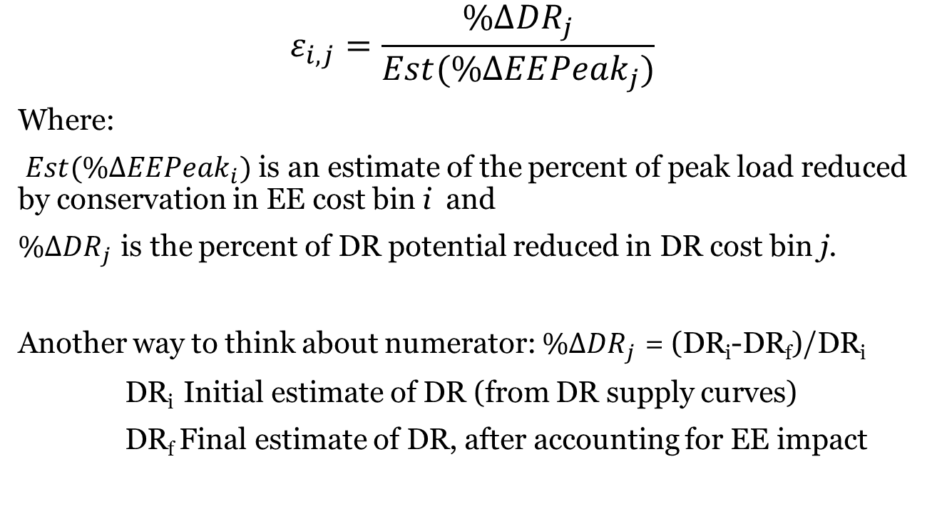
Formulation of Interaction Factor
$$ε_{i,j}=\frac{\%Δ{DR}_{j}}{Est(\%ΔEE{Peak}_{j})}$$
Where:
${Est(\%∆EEPeak}_{i})$ is an estimate of the percent of peak load reduced by conservation in EE cost bin i and
${\%∆DR}_{j}$ is the percent of DR potential reduced in DR cost bin j.
Another way to think about numerator: ${\%∆DR}_{j}$ = (DR_{i}-DR_{f})/DR_{i}
DR_{i} Initial estimate of DR (from DR supply curves)
DR_{f} Final estimate of DR, after accounting for EE impact

Slide 15
DR/EE Elasticity Sample
EE Bin | 1 | 2 | 3 | 4 | 5 | 6 | 7 | 8 | 9 | 10 | 11 | 12 | 13 | 14
DR Bin 1 | 0.1 | 0.1 | 0.1 | 7.3 | 0.1 | 0.1 | 5.2 | 0.1 | 0.1 | 0.1 | 0.1 | 0.1 | 0.1 | 0.1
DR Bin 2 | 0.3 | 0.1 | 0.1 | 0.0 | 0.1 | -2.1 | 0.3 | -6.1 | 0.4 | -6.6 | -5.0 | 0.3 | 0.5 | 0.5
DR Bin 3 | 0.0 | 0.0 | 0.0 | 0.0 | 0.0 | 2.4 | 0.0 | 18.5 | 12.6 | 7.4 | 5.7 | 5.8 | 0.0 | 2.2
DR Bin 4 | 0.0 | 0.0 | 0.0 | 0.0 | 0.0 | 0.4 | 0.0 | 2.6 | 1.5 | 1.3 | 1.7 | 0.9 | 0.0 | 0.3

Slide 16
The Effect of DR/EE Interaction Factor Depends
Mostly on size of DR program, but also on size of EE impact.
The numbers depend on what makes up the bin.
The general effect is that EE diminishes the DR potential, but some measure/program interactions increase DR slightly

Slide 17
Questions
John Ollis
jollis@nwcouncil.org

